Slide 1
Cultivation of bacteria
Inoculation , incubation and purification methods
Dr. Rana Adnan Fayez

Slide 5
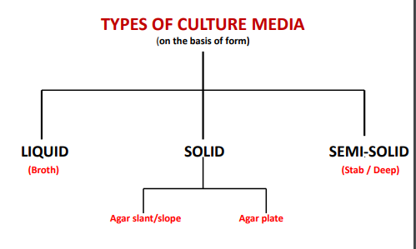

Slide 6
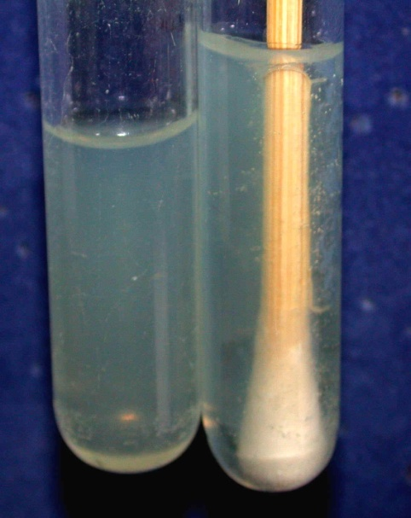
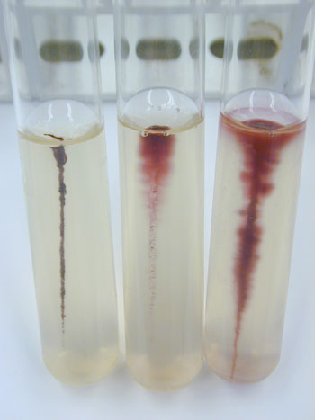

Slide 7
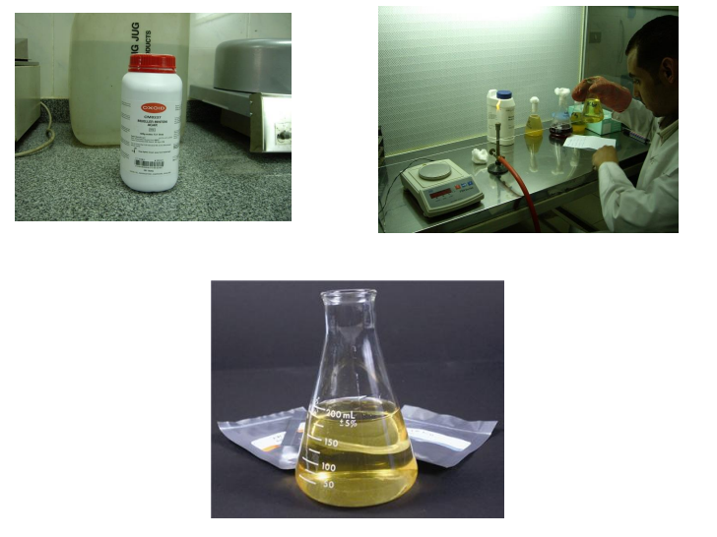

Slide 9
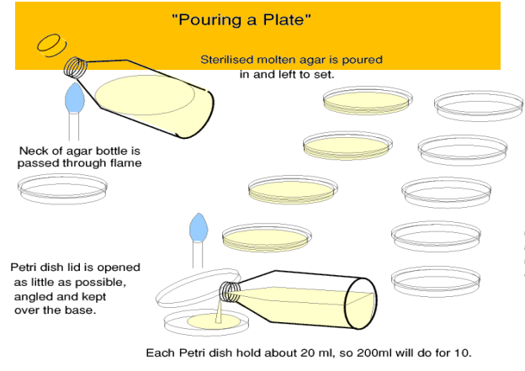

Slide 11
*aerobic incubation is uniformly done at 37ºC.
Depending upon the workload a laboratory may have a tabletop incubator or a walk-in incubator.
prolonged incubations, as required for the growth of Mycobacterium tuberculosis, screw-capped bottles should be used instead of Petri dishes or tubes to prevent the drying of medium.

Slide 12
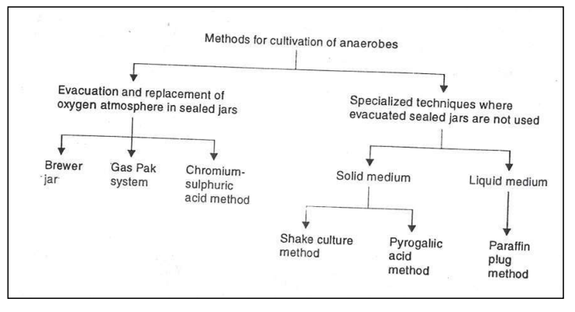

Slide 13
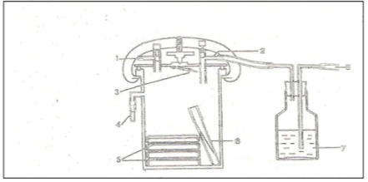

Slide 14
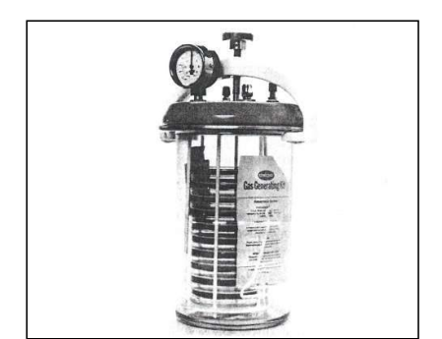

Slide 15
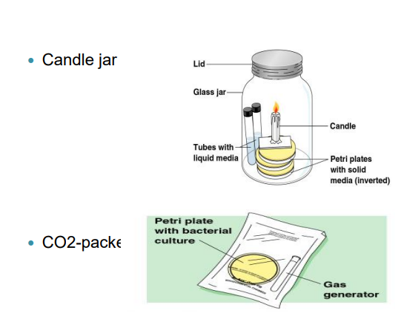

Slide 19
The Requirements for Growth in Oxygen (O2):
Results:
growth only at top = obligate aerobe
growth only at bottom = obligate anaerobe ,
lighter growth at bottom heavy growth at top=
= facultative anaerobe
growth only in middle = microaerophile

Slide 20
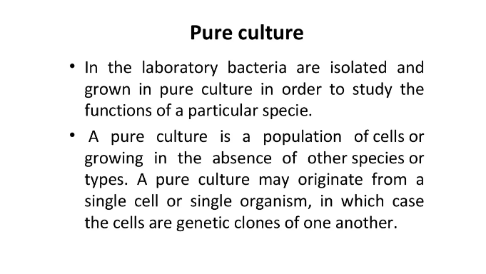

Slide 21
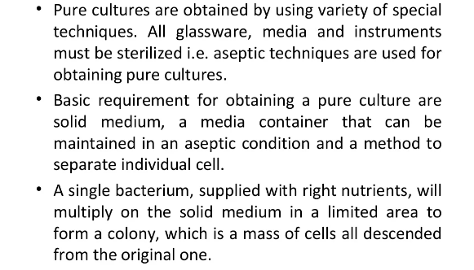

Slide 23
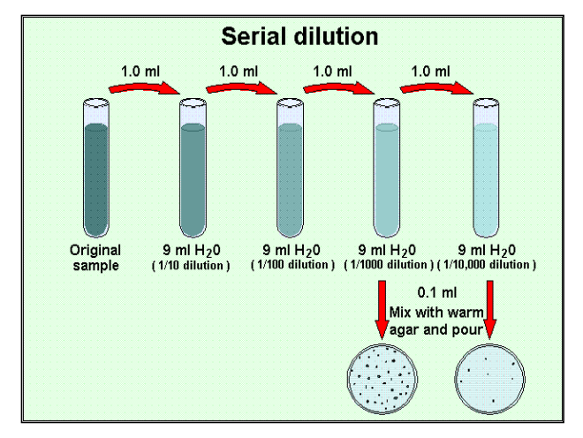

Slide 24
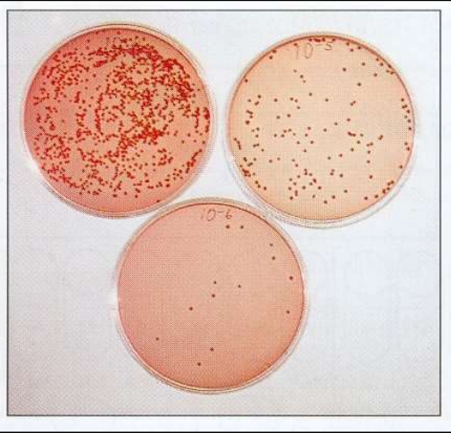

Slide 27
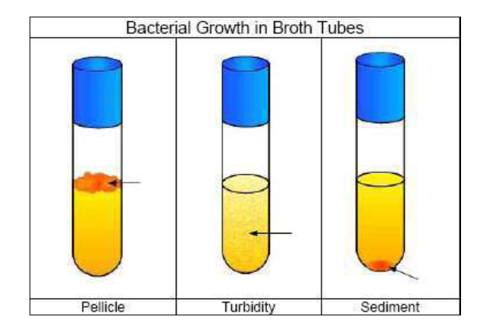

Slide 29
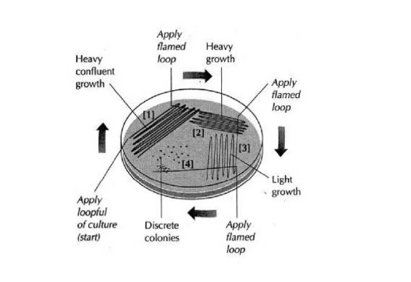

Slide 30
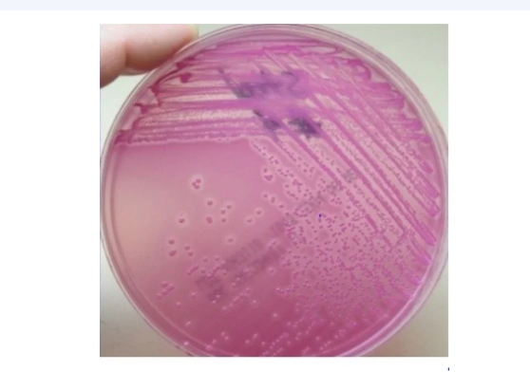

Slide 31
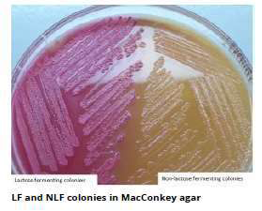
MacConkey agar EMB agar manitole salts agar

Slide 35
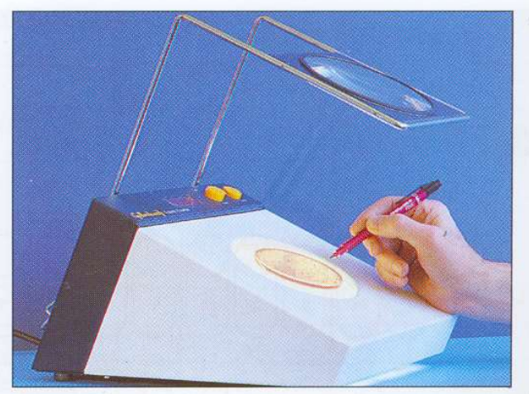

Slide 39
